Slide 1
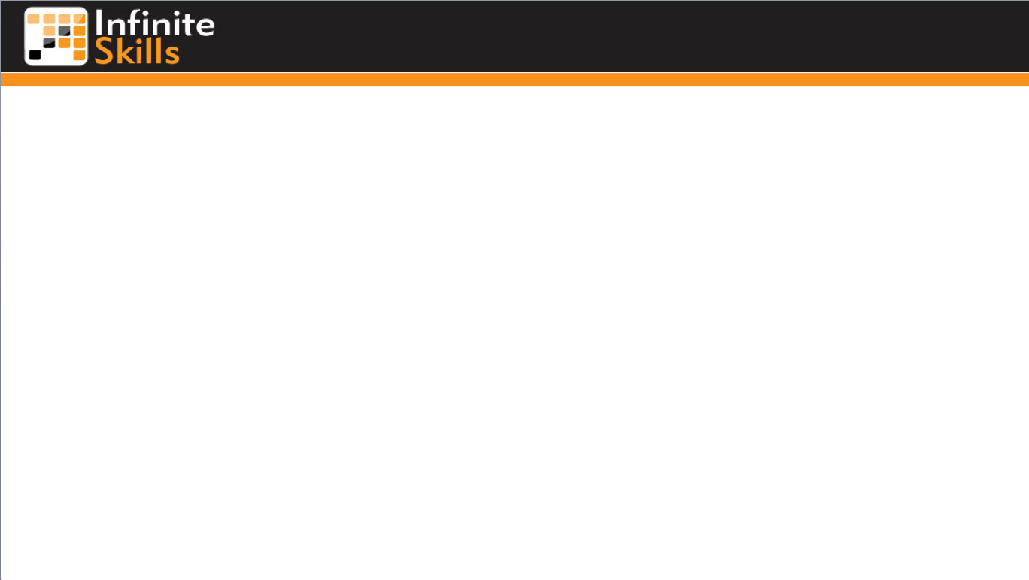
Security Considerations
Steve Perry
Email: steveperrymail@yahoo.com

Slide 2
Stop the Hackers!
User Authentication
Your PHP Program can be called from any Web page!
Recheck on the server-side
Never use JavaScript for anything security related!
SQL Injection
Non-obvious table names
Instead of “author”, “hfe_author_5”
Check for key words:
Show Tables, Delete, Drop,
Check String Lengths

Slide 3
End

Slide 4
What is a Relational Database?
A Relational Database
Stores data in Tables (grid-like format, similar to a spreadsheet)
MySQL is used for structuring, querying, and changing information in these tables
Notes:
21

Slide 5
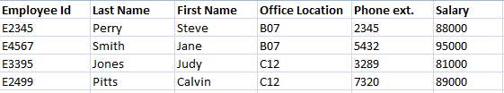
What are Tables?
They have Rows and Columns (like a spreadsheets with rows & columns)
Notes:
23

Slide 6
End

